Slide 1

IT2060
Operating Systems and System Administration
Lecture 10
Memory Management

Slide 2
Memory Management
Background
Swapping
Contiguous Memory Allocation
Paging

Slide 3
Main Memory
Memory is a large array of words or bytes, each with its own address
  It is a repository of quickly accessible data shared by CPU and I/O devices.
  Memory and registers are the only storage that CPU can directly access
Main memory is a volatile storage device
  It loses its contents in the case of system failure.
A program must be mapped to absolute addresses and loaded into memory.
The OS is responsible for the following activities:
  Keep track of which parts of memory are being used and by whom.
  Decide which processes to load next when memory space becomes available.
  Allocate and deallocate memory.
CPU
Memory
I/O

Slide 4
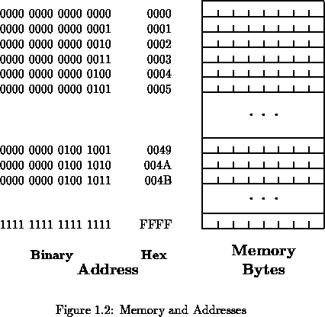
For n bits address, the memory capacity = 2^{n} bytes
Program must be brought (from disk) into memory and placed within a process for it to be run
Main memory and registers are only storage CPU can access directly
Memory unit only sees a stream of addresses + read requests, or address + data and write requests
Register access in one CPU clock (or less)
Protection of memory required to ensure correct operation

Slide 5
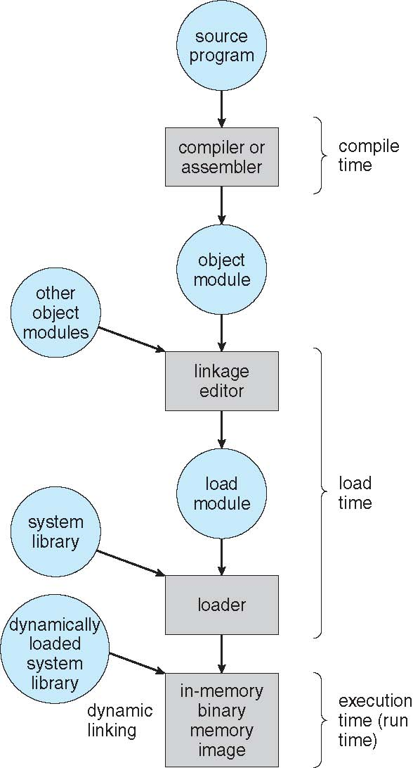
Address Binding
Address binding of instructions and data to memory addresses can happen at three different stages
  Compile time: If memory location known a priori, absolute code can be generated; must recompile code if starting location changes
  Load time: Must generate relocatable code if memory location is not known at compile time
  Execution time: Binding delayed until run time if the process can be moved during its execution from one memory segment to another
    Need hardware support for address maps (e.g., base and limit registers)

Slide 6
Logical vs. Physical Address Space
The concept of a logical address space that is bound to a separate physical address space is central to proper memory management
  Logical address – generated by the CPU; also referred to as virtual address
  Physical address – address seen by the memory unit
Logical and physical addresses are the same in compile-time and load-time address-binding schemes; logical (virtual) and physical addresses differ in execution-time address-binding scheme
Logical address space is the set of all logical addresses generated by a program
Physical address space is the set of all physical addresses generated by a program

Slide 7
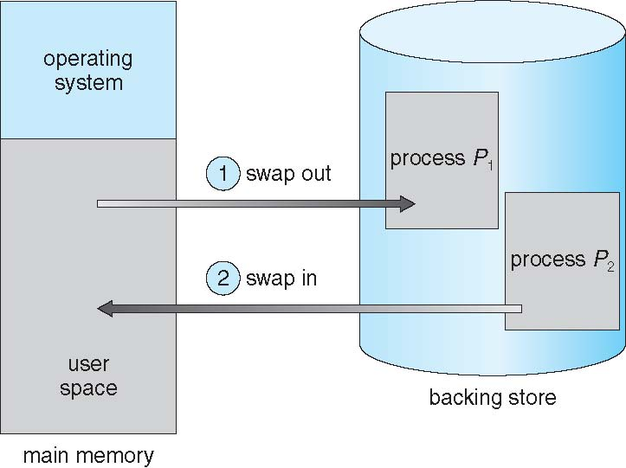
Swapping
A process can be swapped temporarily out of memory to a backing store, and then brought back into memory for continued execution
  Total physical memory space of processes can exceed physical memory

Slide 8
Roll in – Roll out
Roll out, roll in – swapping variant used for priority-based scheduling algorithms; lower-priority process is swapped out so higher-priority process can be loaded and executed

Slide 9
Contiguous Allocation
Main memory must support both OS and user processes
Limited resource, must allocate efficiently
Contiguous allocation is one early method
Main memory usually into two partitions:
  Resident operating system, usually held in low memory with interrupt vector
  User processes then held in high memory
  Each process contained in single contiguous section of memory

Slide 10
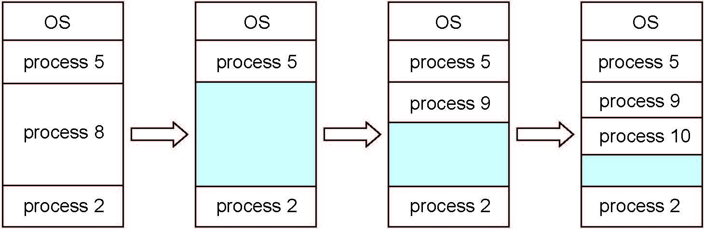
Multiple-partition allocation
Multiple-partition allocation
  Degree of multiprogramming limited by number of partitions
  Variable-partition sizes for efficiency (sized to a given process’ needs)
  Hole – block of available memory; holes of various size are scattered throughout memory
  When a process arrives, it is allocated memory from a hole large enough to accommodate it
  Process exiting frees its partition, adjacent free partitions combined
  Operating system maintains information about:
  a) allocated partitions b) free partitions (hole)

Slide 11
Dynamic Storage-Allocation Problem
How to satisfy a request of size n from a list of free holes?
First-fit: Allocate the first hole that is big enough
Best-fit: Allocate the smallest hole that is big enough; must search entire list, unless ordered by size
  Produces the smallest leftover hole
Worst-fit: Allocate the largest hole; must also search entire list
  Produces the largest leftover hole
First-fit and best-fit better than worst-fit in terms of speed and storage utilization

Slide 12
Fragmentation
External Fragmentation – total memory space exists to satisfy a request, but it is not contiguous
Internal Fragmentation – allocated memory may be slightly larger than requested memory; this size difference is memory internal to a partition, but not being used
First fit analysis reveals that given N blocks allocated, 0.5 N blocks lost to fragmentation
  1/3 may be unusable -> 50-percent rule

Slide 13
Fragmentation (Cont.)
Reduce external fragmentation by compaction
  Shuffle memory contents to place all free memory together in one large block
  Compaction is possible only if relocation is dynamic, and is done at execution time
  I/O problem
    Latch job in memory while it is involved in I/O
    Do I/O only into OS buffers
Now consider that backing store has same fragmentation problems

Slide 14
Paging
Physical address space of a process can be noncontiguous; process is allocated physical memory whenever the latter is available
  Avoids external fragmentation
  Avoids problem of varying sized memory chunks
Divide physical memory into fixed-sized blocks called frames
  Size is power of 2, between 512 bytes and 16 Mbytes
Divide logical memory into blocks of same size called pages
Keep track of all free frames
To run a program of size N pages, need to find N free frames and load program
Set up a page table to translate logical to physical addresses
Backing store likewise split into pages
Still have Internal fragmentation

Slide 16
Address Translation Scheme
Address generated by CPU is divided into:
  Page number (p) – used as an index into a page table which contains base address of each page in physical memory
  Page offset (d) – combined with base address to define the physical memory address that is sent to the memory unit
For given logical address space 2^{m} and page size 2^{n}

Slide 17
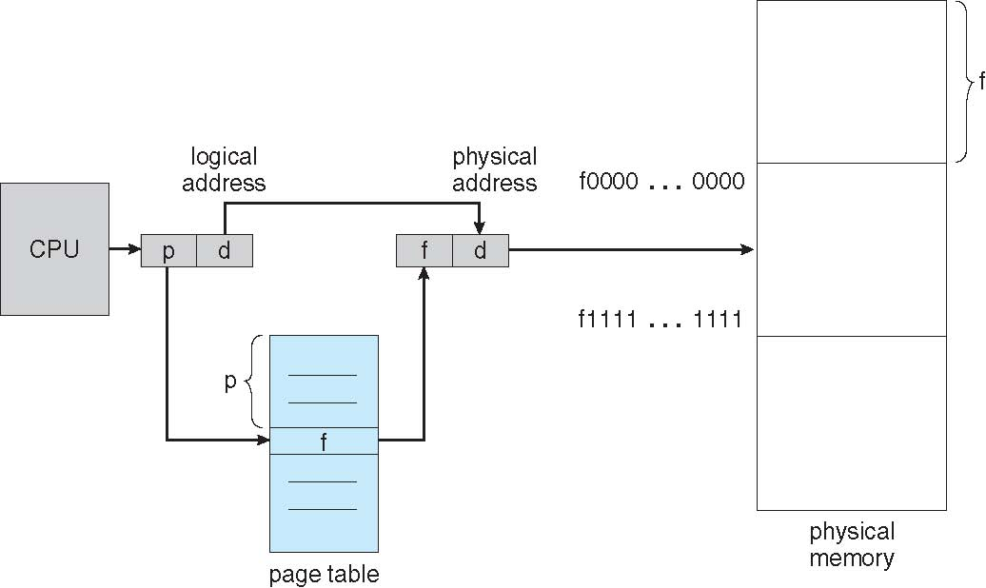
Paging Hardware

Slide 18
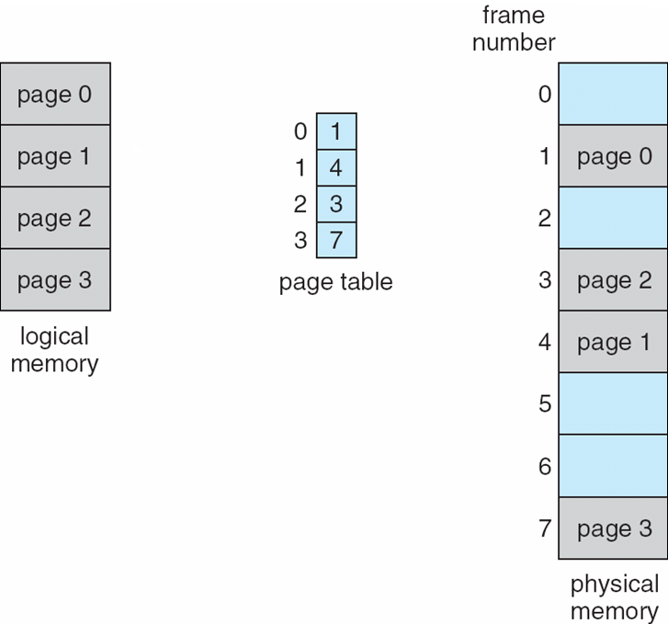
Paging Model of Logical and Physical Memory

Slide 19
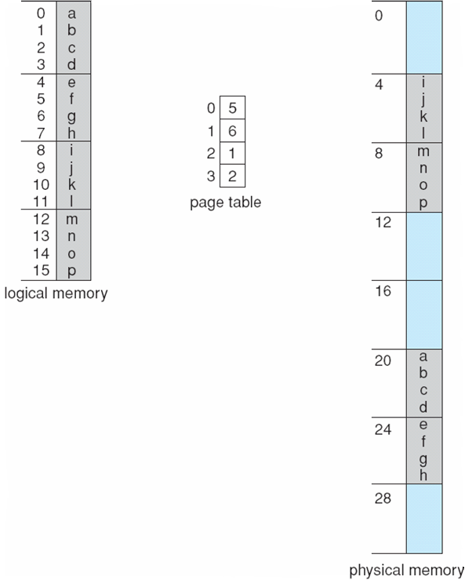
Paging Example
n=2 and m=4 32-byte memory and 4-byte pages

Slide 20
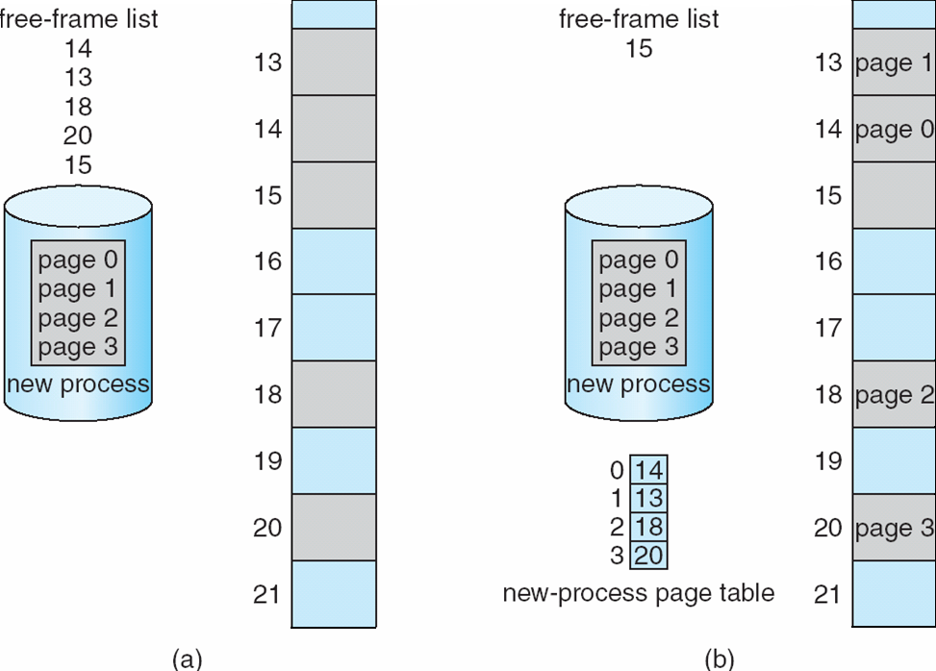
Free Frames
Before allocation
After allocation

Slide 21
Associative memory – parallel search
Address translation (p, d)
  If p is in associative register, get frame # out
  Otherwise get frame # from page table in memory

Slide 22
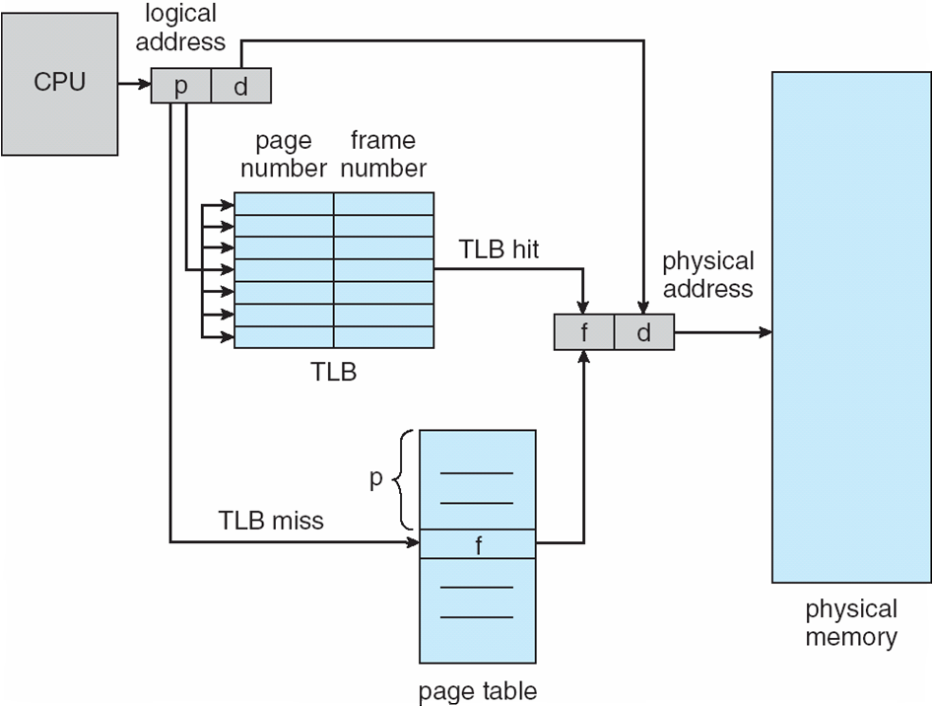
Paging Hardware With Associative Memory (TLB)

Slide 23
Effective Access Time
Associative Lookup = ε time unit
  Can be < 10% of memory access time
Hit ratio = α
  Hit ratio – percentage of times that a page number is found in the associative registers; ratio related to number of associative registers
Consider α = 80%, ε = 20ns for TLB search, 100ns for memory access
Effective Access Time (EAT)
EAT = (1 + ε) α + (2 + ε)(1 – α)
= 2 + ε – α
Consider α = 80%, ε = 20ns for TLB search, 100ns for memory access
  EAT = 0.80 x 100 + 0.20 x 200 = 120ns
Consider more realistic hit ratio -> α = 99%, ε = 20ns for TLB search, 100ns for memory access
  EAT = 0.99 x 100 + 0.01 x 200 = 101ns

Slide 24
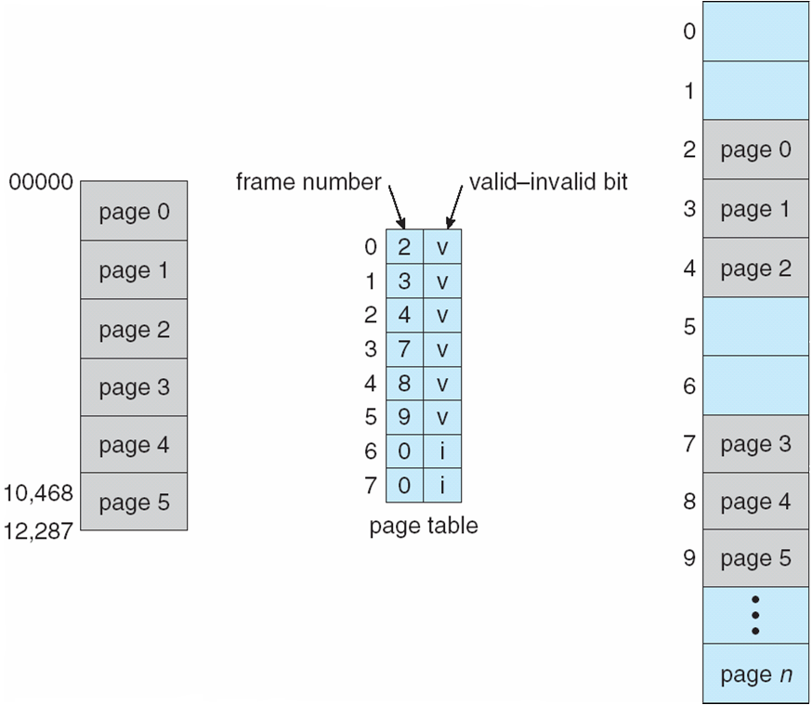
Memory Protection
Memory protection implemented by associating protection bit with each frame to indicate if read-only or read-write access is allowed
  Can also add more bits to indicate page execute-only, and so on
Valid-invalid bit attached to each entry in the page table:
  “valid” indicates that the associated page is in the process’ logical address space, and is thus a legal page
  “invalid” indicates that the page is not in the process’ logical address space
  Or use page-table length register (PTLR)
Any violations result in a trap to the kernel

Slide 25
Page Table Structures
Hierarchical Paging.
Hashed Page Tables.
Inverted Page Tables.
Hierarchical Paging
Most modern computer systems support a very large logical address, e.g., 2³² to 2⁶⁴ → page table becomes very large.
Example: For a system with 32 bit logical address, and page size = 4KB (12 bits offset)
  page table = 1 Million entries (32-12 = 20 bits) → 4 MB of physical address spaces for page table; 2²⁰ * 4 bytes/entry
One solution is to divide the page table into smaller pieces
  For a two-level paging scheme, the page table itself is also paged.

Slide 26
Two-level paging example
A logical address (on 32-bit machine with 4K page size) is divided into:
  a page number consisting of 20 bits.
  a page offset consisting of 12 bits.
Since the page table is paged, the page number is further divided into:
  a 10 bit page number.
  a 10 bit page offset.
Thus, a logical address is as follows:
Page number
Page offset
p₁ p₂ d
10
10
12
p₁ is an index into the outer page table, and p₂ is the displacement within the page of the inner page table
  Translation starts from the outer page table

Slide 27
Two-level paging example
1
1
.
500
100
500
100
.
708
708
900
Outer-page table
929
900
.
929

Slide 28
Address-translation scheme
Two-level 32-bit paging architecture
Logical address
p₁ p₂ d
p₁
p₂
d
Outer-page table
Page of page table

Slide 29
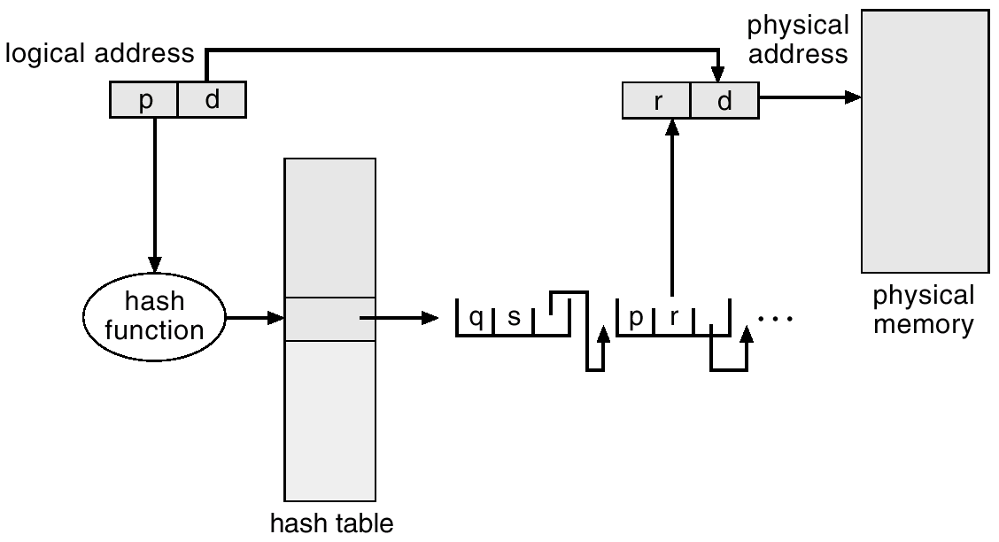
Hashed Page Tables
Is commonly used when address spaces > 32 bits.
The virtual page number is hashed into a page table.
  This page table contains a chain of elements hashing to the same location.
  Each element contains: virtual page number, the value of the mapped frame, pointer to the next element
Virtual page number is compared in this chain searching for a match.
  If a match is found, the corresponding physical frame is extracted.
For address spaces > 64 bits, use Clustered page tables.
  Similar to hash page table except each entry in page table refers to several pages (e.g., 16).

Slide 30
Inverted Page Table
In the paging system, each process has a page table associated with it.
  Drawback: each page table may consist of millions of entries → page tables consume large amount of physical memory.
To solve this problem, use Inverted Page Table.
  It uses ONLY one table that has one entry for each real page of memory.
Each entry consists of the virtual address of the page stored in that real memory location, with information about the process (e.g., PID) that owns that page.
This scheme decreases memory needed to store each page table, but increases time needed to search the table when a page reference occurs.
  It may use hash table to limit the search to one – or at most a few page table entry.

Slide 31
Inverted page table architecture
Logical address
Physical
memory
CPU
pid p d
i d
physical address
search
Pid p
i
Page table

Slide 32
End of Lecture 10

